Slide 1

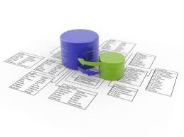


Databases for Developers
Database Course Program, Evaluation, Exams
Databases
Telerik Software Academy
http://academy.telerik.com

Slide 2

Table of Contents
What's Coming Next in the Academy?
The Databases Course Program
The Trainers Team
Exams and Evaluation
Standard Criteria
Bonuses
Resources for the Course
HQC Champions

Slide 3

Databases for Developers
Coming To The Next Module

Slide 4

What's Coming Next?
Two courses at the same time
Databases for Developers Course
Lectures every working day in the week
From 10:30 to 18:00
Practical exam after 3 weeks
Data structures and algorithms
Lectures 3 times a week
Every Monday, Wednesday and Friday from 18:00 to 22:00
Practical exam after 4 weeks

Slide 5
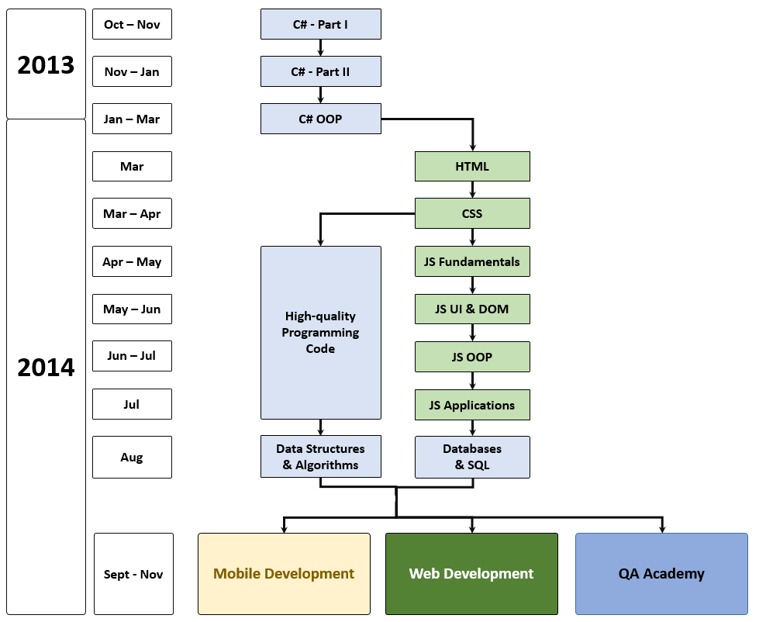
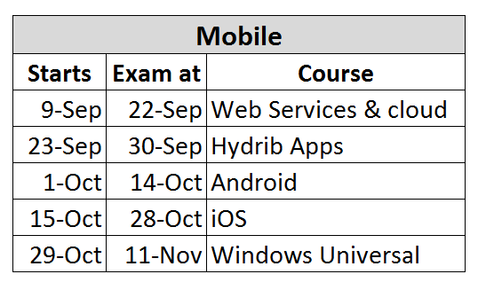
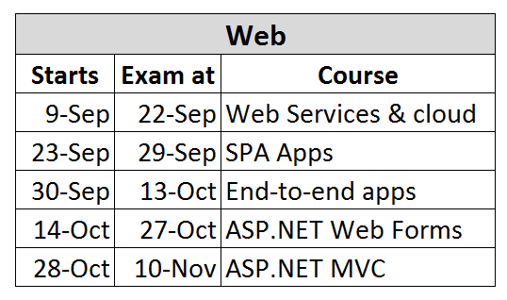
What's Coming Next?

Slide 6

Databases – Program
What Will We Cover in the Databases Course?

Slide 7


The Databases Course Program
Database Systems – Overview
SQL Server and MySQL – Introduction
Data Modeling and ER Diagrams
Intro to SQL
Advanced SQL
Transact-SQL
ADO.NET
ADO.NET Entity Framework
Entity Framework Performance

Slide 8



The Databases Course Program
Code First in Entity Framework
Database Performance
Database Transactions
NoSQL Databases
XML Basics
Processing XML in .NET
Databases Team Work Project
Exam Preparation
Exam

Slide 9

The Trainers Team

Slide 10
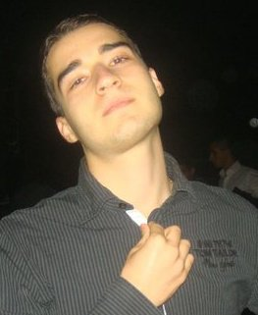
Trainers Team
Nikolay Kostov
Team Lead, Senior Developer and Trainer @ Telerik Corp.
Student at Sofia University
Computer Science
IT and Informatics competitions contestant
Graduate from the second season of Telerik Software Academy
Email: nikolay.kostov [at] telerik.com
Blog: http://nikolay.it

Slide 11
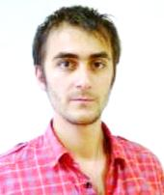
Trainers Team (2)
Doncho Minkov
Senior Technical Trainer @ Telerik Software Academy
Student in Sofia University
Software Engineering
Contestant in the Informatics competitions
Graduate from the first season of Telerik Software Academy
Email: doncho.minkov [at] telerik.com
Blog: http://minkov.it

Slide 12
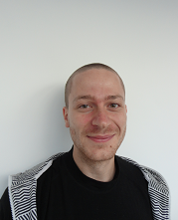
Trainers Team (3)
Ivaylo Kenov
Technical Trainer @ Telerik Software Academy
Graduate from the fourth season of Telerik Software Academy
Mathematical competitions contestant
E-mail: ivaylo.kenov [at] telerik.com
Champion in OOP and DSA
http://ivaylo.bgcoder.com

Slide 13
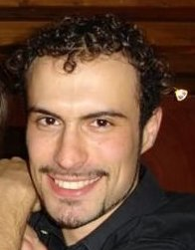
Trainers Team (4)
Evlogi Hristov
Technical Trainer @ Telerik Software Academy
Graduate from the fourth season of Telerik Software Academy
E-mail: evlogi.hristov [at] telerik.com

Slide 14





Evaluation
Thank God There Are Bonuses!

Slide 15

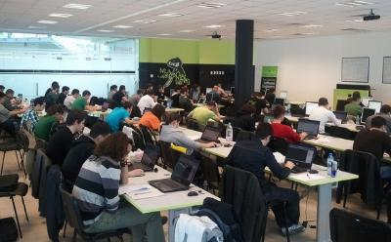
Databases – Evaluation
Evaluation components
Practical exam – 55%
Peer review – 10 exams
Teamwork – 20%
Homework – 10%
Homework evaluation – 5%
3 peer reviews per homework (excellent, OK, bad)
Attendance in class – 10%
Bonuses
Forums activity – bonus up to 5%

Slide 16


Pass / Excellence / Fail Criteria
Criteria for pass / pass with excellence / fail
Pass with excellence
Very high exam results
or
High total results
Pass
Average total results
Fail
Low total results or low exam results

Slide 17
Homework Peer Reviews
Everyone will get feedback for their homework
Everyone will give feedback for few random homework submissions
Students submit homework anonymously
Please exclude your name from the submissions!
For each homework submitted
Students evaluate 3 random homeworks
From the same topic, after the deadline
Homework comments are not obligatory

Slide 18
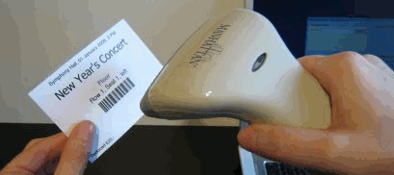
Check Your Presence
From now on you should check your presence on the barcode reader 2-3 times a day:
In the morning when lectures begin (~10:30)
After lunch break (~13:30)
When you have data structures and algorithms when the lecture starts (~18:00)

Slide 19








Resources
What We Need in Addition to this Course Content?

Slide 20

Course Web Site & Forums
Register for the "Telerik Academy Forums":
Discuss the course exercises with your colleagues
Find solutions for the exercises
Share source code / discuss ideas
The databases official web site:
http://forums.academy.telerik.com/web-development/databases
http://academy.telerik.com/student-courses/software-technologies/databases/about

Slide 21
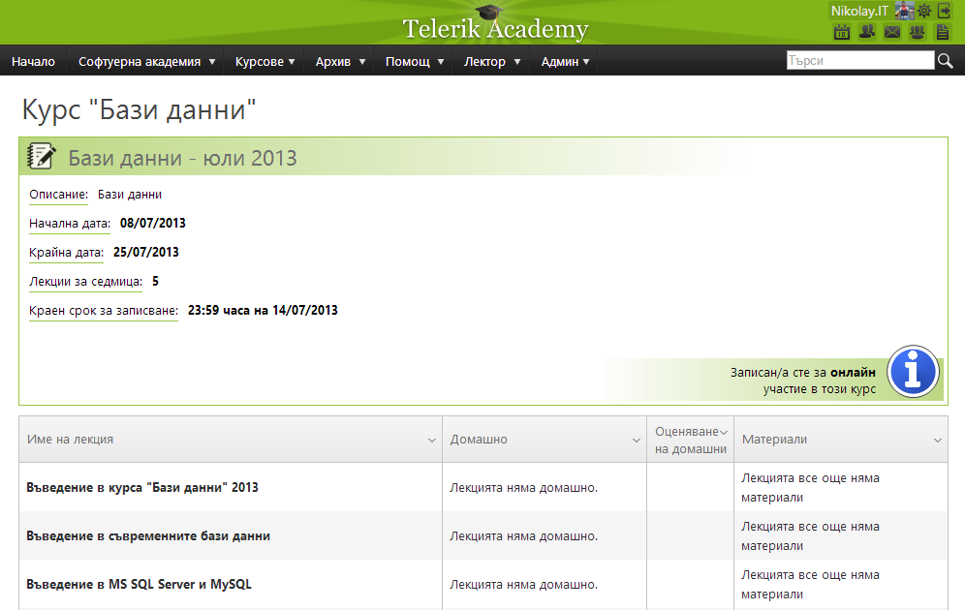
Telerik Integrated Learning System (TILS)
The Telerik Integrated Learning System (TILS)
www.telerikacademy.com
Important resource for all students
Homework submissions
Homework peer reviews
Presence cards with barcode
Reports about your results
telerikacademy.com/Courses/Courses/Details/185

Slide 22


Required Software
Software needed for this course:
Microsoft Visual Studio 2012/2013
Microsoft SQL Server 2012 Developer with Service Pack 1 and Developer Tools
Or SQL Server 2014
MySQL Community Server 5.x
MySQL Workbench

Slide 23


Champions from the Exams
Telerik Academy Ninja Champions

Slide 24


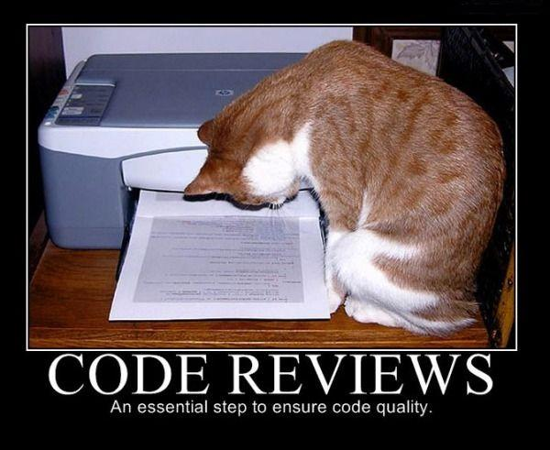
Champions: HQC
# 1 – Djenko Penev
# 2 – Ventsislav Georgiev
# 3 – Alexander Dimitrov

Slide 25


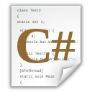


Databases: Course Introduction
http://academy.telerik.com

Slide 26




Free Trainings @ Telerik Academy
C# Programming @ Telerik Academy
csharpfundamentals.telerik.com
Telerik Software Academy
academy.telerik.com
Telerik Academy @ Facebook
facebook.com/TelerikAcademy
Telerik Software Academy Forums
forums.academy.telerik.com

